Slide 1
Lecture 10: Least Squares

Slide 2
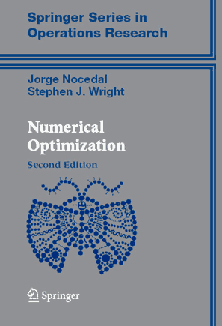
Textbook
Nocedal, Wright

Slide 3
Linear least squares setting
Least squares the most widely used data fitting model in statistics, science, engineering, etc.
Data matrix (aka observation matrix):
a vector of input variables (observations, independent variables, features, predictors, regressors)

Slide 4
Linear least squares setting
Outcomes (dependent variables, response)

Slide 5
Linear least squares setting
Model to be recovered by optimization.
“noise”

Slide 6
Linear least squares setting
“noise”
w that gives the best fit (in the least-quadratic sense) is then recovered by:
Residual vector:
We can rewrite:

Slide 7
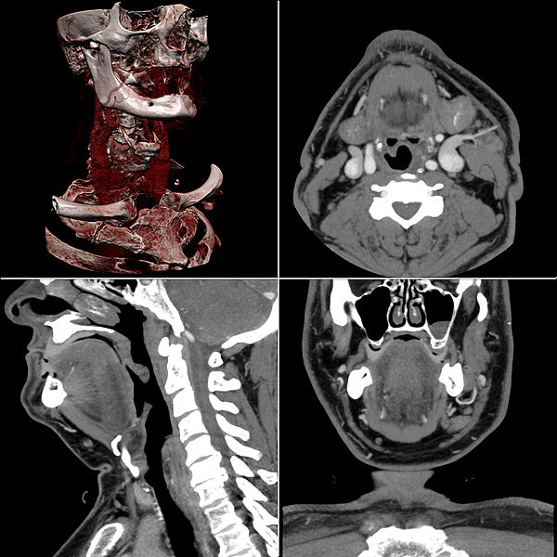
Computer tomography
Image from wikipedia

Slide 8
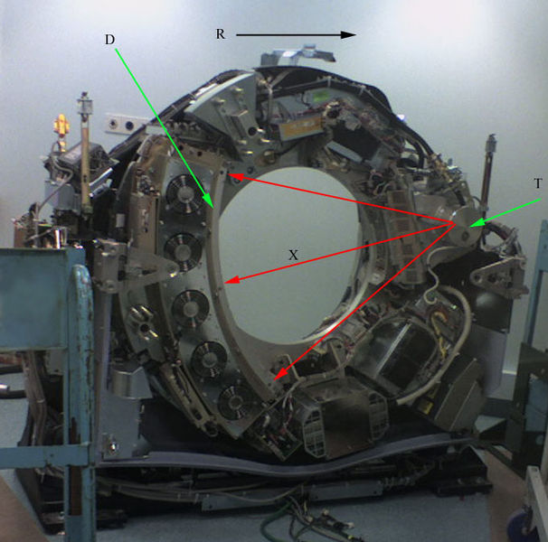
Computer tomography
Image from wikipedia

Slide 9

Computer tomography
sensors
X-ray emitter

Slide 10
Computer tomography

Slide 11
Computer tomography

Slide 12
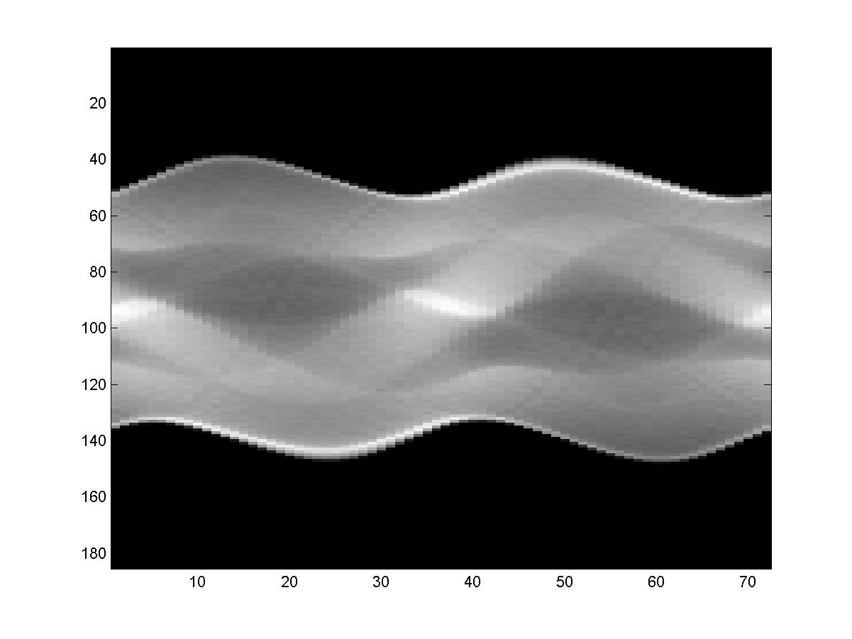
A sinogram
Sensor number
Gantry angle

Slide 13

The least squares model
1 | 2 | 3 | 4 | 5
 |  |  |  |  |  | 61 | 62 | 63
each row corresponds to one ray
=
+
NOISE
SINOGRAM
CT IMAGE

Slide 14
Finding the minimum
Differentiating w.r.t. w and setting the gradient to zero, we get:
After algebra, we get normal equations:
If normal equations are full rank, then:

Slide 15
Adding non-linearity
We can adapt linear least squares to fitting non-linear functions, by transforming the input x non-linearly:
Our data matrix then becomes:
Then, linear least squares proceed as before.

Slide 16
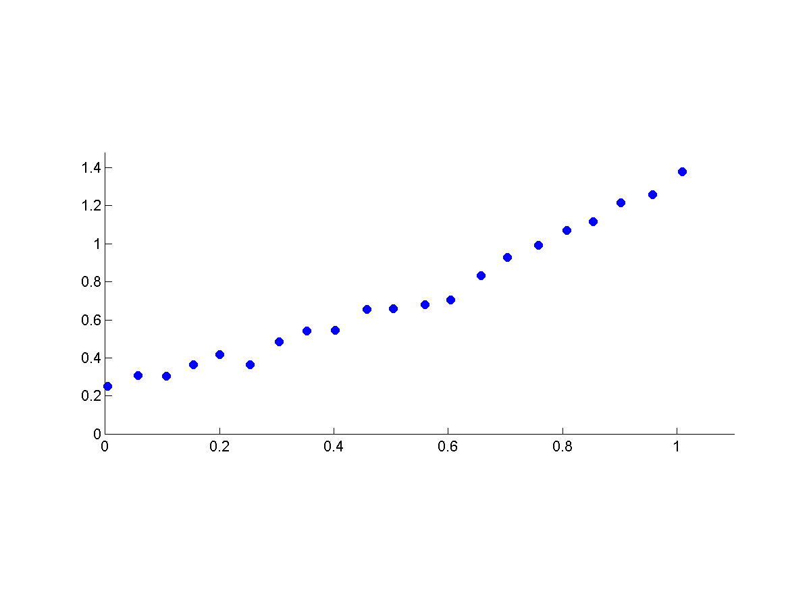
Example fitting the data

Slide 17
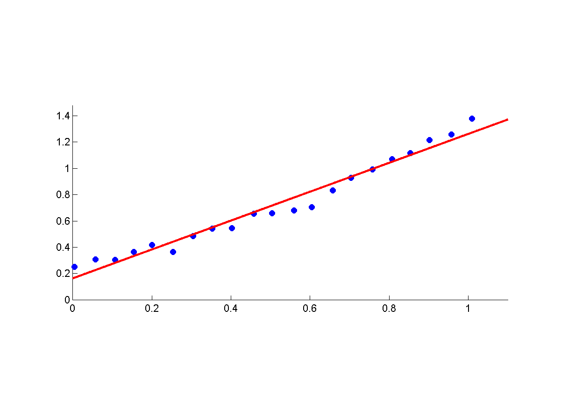
Example fitting the data

Slide 18
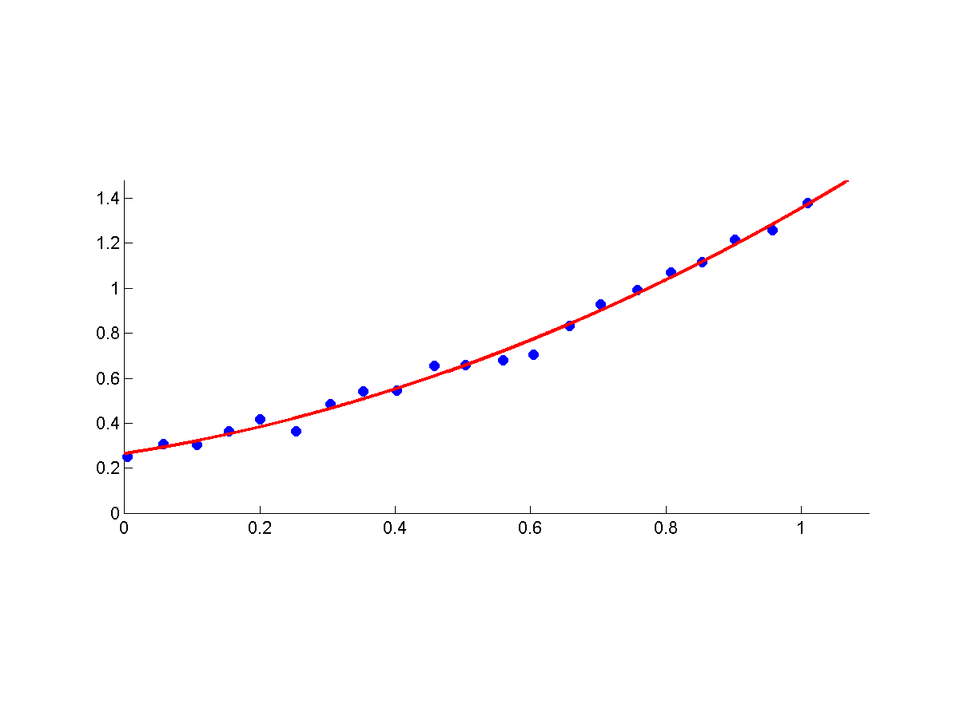
Example fitting the data

Slide 19
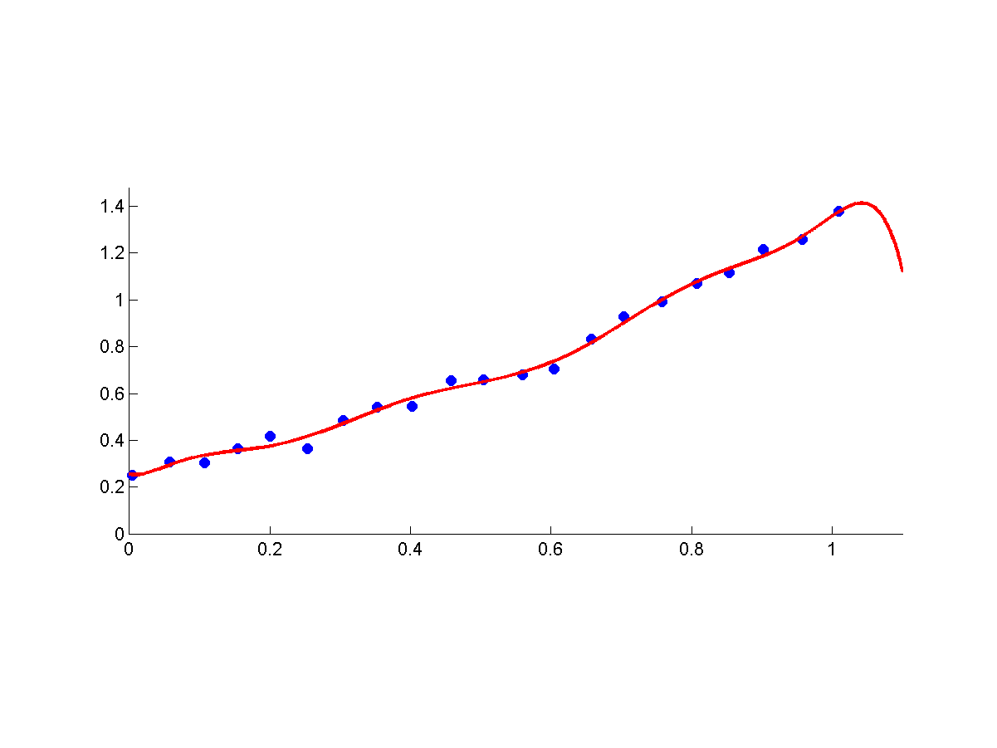
Example fitting the data
overfitting

Slide 20
Choosing the right model
The most straight-forward and commonly used method is validation:
Split data into training and validation
Fit all models on training
Check how well do they perform on validation
Pick the best performer
Reestimate the model using full set

Slide 21


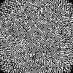
Overfitting in computer tomography
Tomographic reconstruction suffers from overfitting as well:
"True" phantom used to generate the data:
Reconstruction (no noise):
Reconstruction with noise:

Slide 22
(Not fully) Bayesian approach
Our model (in the linear case):
“noise”
Let us look at:
Using Bayes rule:
likelihood
prior
posterior
We will now model the factors and then try to find w that maximizes the probability.

Slide 23
(Not fully) Bayesian approach
log-likelihood
log-prior
Different choices of log-likelihood and log-prior give rise to different regression methods with different statistical and computational performance

Slide 24
Tikhonov-regularized least-squares
“noise”
log-likelihood
log-prior
We assume that the noise is independent between measurements and Gaussian. Then our likelihood is:
We assume that w is drawn from an isotropic zero-mean Gaussian prior:
Thus we get:

Slide 25
Finding the minimum
Differentiating w.r.t. w and setting the gradient to zero, we get:
After algebra, we get normal equations:
We can express w as:

Slide 26
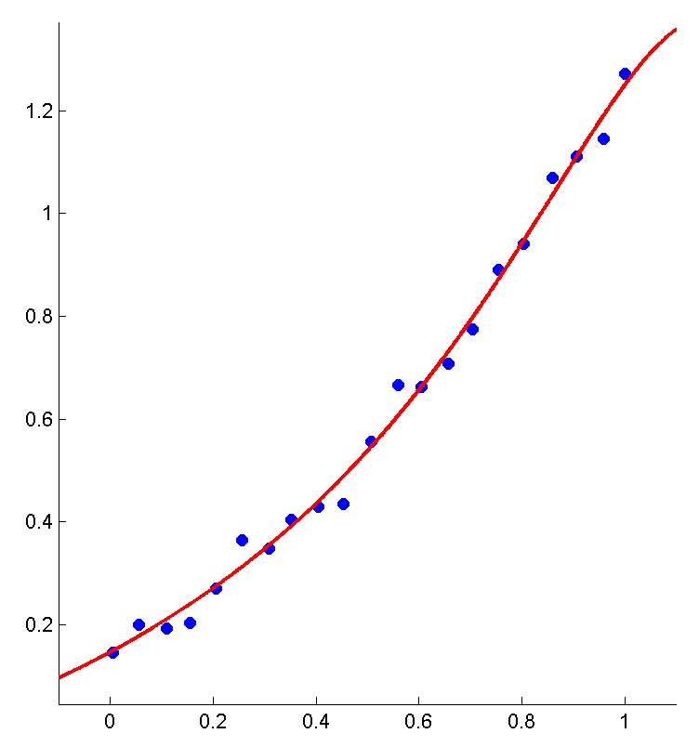
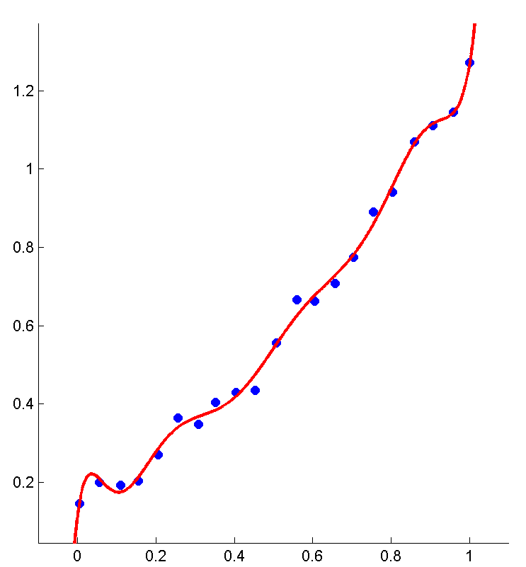
Fitting with regularization
Fitting degree 10 polynomial:
No regularization

Slide 27

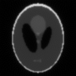

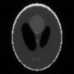
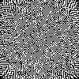
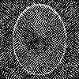

Tomography with regularization
No regularization
Strong regularization
Result from 90 angles
No noise
Strong noise

Slide 28
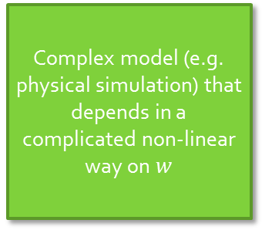
Non-linear least squares
Typical usage scenario:
Complex model (e.g. physical simulation) that depends in a complicated non-linear way on $w$

Slide 29
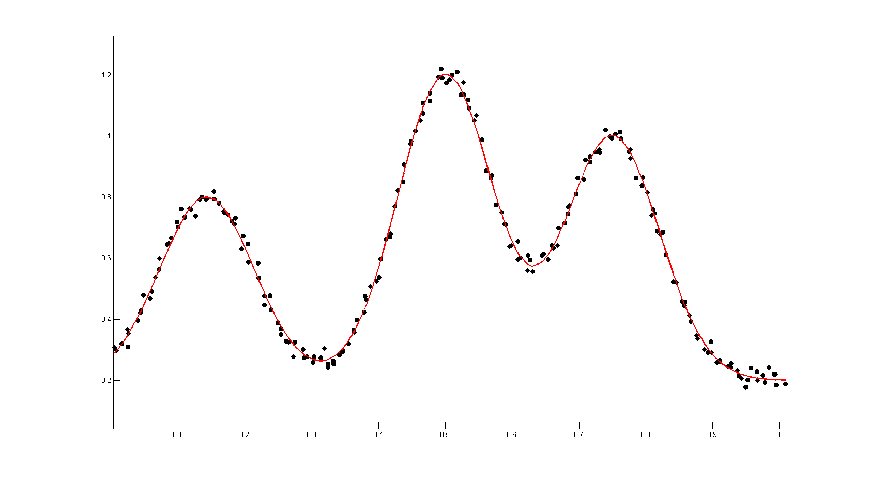
Nonlinear curve fitting

Slide 30
Nonlinear curve fitting
Assume that the noise is Gaussian, then to recover w we need to solve:

Slide 31
Non-linear least squares
The gradient of the objective function is:
, where the Jacobian J is:

Slide 32
Non-linear LS : gradient descent
We can try a standard gradient descent. We use a first order approximation in the vicinity of the current estimate w^{t}:
We then do steps along the gradient according some schedule s_{t} (or using line search):
Reminder:

Slide 33
Non-linear LS: second-order method
Gradient descent is slow. Instead, we can get much faster convergence by looking at a second-order approximation:
Reminder:
Let us estimate the matrix of second order derivatives:
Or, in more details:

Slide 34
Simplifying the second-order term
Computing green is much easier than red (n first order derivatives vs n² second-order derivatives per each square)
The second-order term is approximated with the green term only (red term is omitted).
This approximation is better for almost linear functions (second derivatives are small) or close to a good minimum (the residual vector is small).

Slide 35
Properties of the approximate Hessian
Easily computable
Easily invertible (when Jacobian is sparse)
Positive (semi)-definite
We are replacing one approximation with another

Slide 36
Non-linear LS: Gauss-Newton method
At each step, the reduced second-order approximation is:
Equate the gradient to zero:
A non-linear version of normal equations (consider linear normal equations for a linear function f(x, w) = x^{T}w at the origin)
Reminder: normal equations in the linear case

Slide 37
Non-linear LS: Gauss-Newton method
Iterative algorithm:
1. Solve
2. Update the current position:
Problem: after two approximations some steps are too large and may lead to the increase/very slow decrease/oscillations.

Slide 38
Levenberg-Marquardt method
On each step of Gauss-Newton we optimize:
The approximation makes sense in the vicinity.
Prevent the steps that are too large by adding an extra term (introducing the "trust region"):

Slide 39
Levenberg-Marquardt method
Equate the gradient to zero:
We arrive at the Levenberg-Marquardt algorithm:
1. Solve
2. Update the current position:
3. If the value is decreased “enough”, decrease λ. Otherwise, step back and increase it.

Slide 40
Interpretation 1
Easily computable
Easily invertible (when Jacobian is sparse)
Positive definite, well conditioned

Slide 41
Interpretation 2
How does the size of the extra term affects the algorithm?
This is Gauss-Newton!
This is gradient descent!
Depending on the size of the extra term, Levenberg-Marquardt switches between gradient descent like behaviour and Newton method-like behaviour.

